Slide 1

Content Projection

Slide 2
Live example
https://angular.io/generated/live-examples/content-projection/stackblitz.html
https://angular.io/guide/content-projection

Slide 3
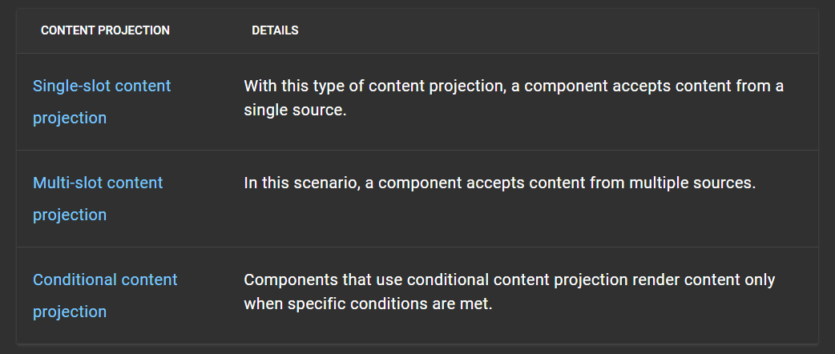
Types of content projections

